Slide 1


Modeling insights from the Austrian national gas grid by 2040 declining natural gas demand and increasing domestic renewable gas generation
Sebastian Zwickl-Bernhard^{1,2}, Hans Auer^{1,2}
¹Energy Economics Group (EEG), Technische Universität Wien, Gußhausstrasse 25-29/E370-3, 1040 Wien, Austria
²Department of Industrial Economics and Technology Management, The Norwegian University of Science and Technology, Sentralbygg 1, 946, Gløshaugen, Trondheim, Norway
The Role of Natural Gas in The Energy Transition / March 15, Trondheim
Regulatory challenges arising from the changes in natural gas supply and demand
Contact: zwickl@eeg.tuwien.ac.at

Slide 2


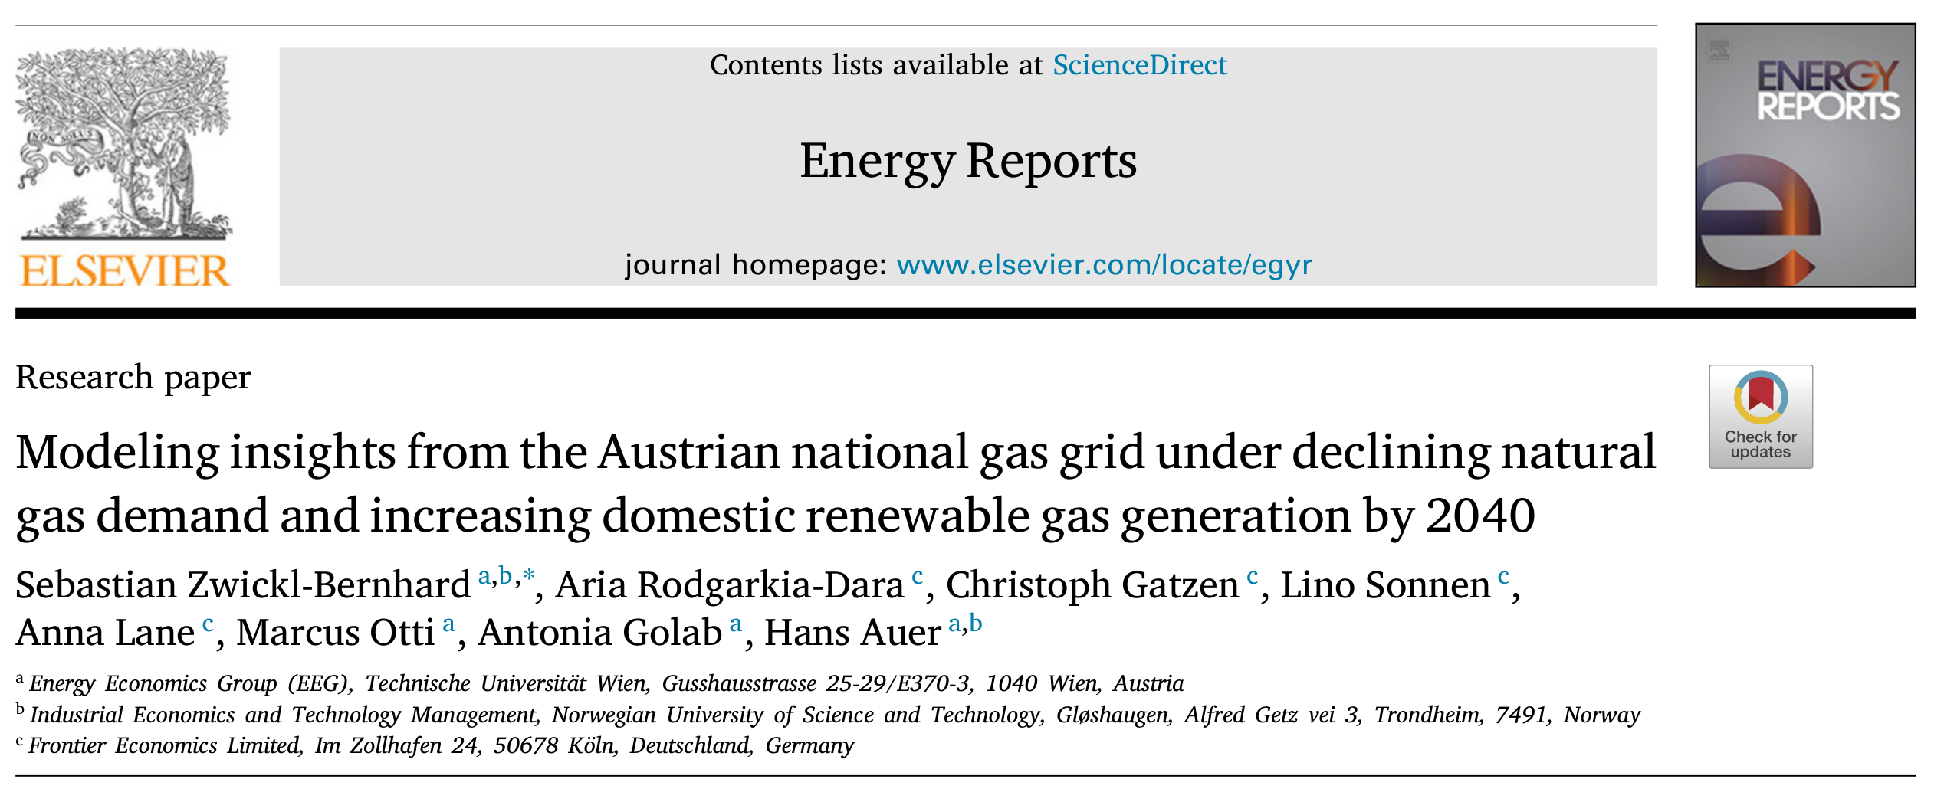

Slide 3
Introduction
Austria was one of the first Western European countries connected to natural gas pipelines, having a long tradition of piped gas supply
‘‘Trans Austria Gas Pipeline’’ (TAG) started operation in 1968 and connected Austria with Slovakia (Russian gas was transported)
This long tradition of natural gas in Austria are reflected in:
high dependence on natural gas for the provision of energy services and
a well-developed gas grid in the country
Unclear as to what extent gas grids will still be needed and whether they can be operated economically

Slide 4
Research Questions
How does Austria’s gas grid develop by 2040 under different decarbonization scenarios of the Austrian and European energy systems, ranging from electrification of most energy services to importing large amounts of renewable methane?
Given the aging nature of gas grids and pipelines, what is the need for replacement investment in the Austrian gas grid by 2040, especially given the expected increase in renewable gas generation (e.g., biomethane and synthetic gas) and its gas grid injection?
How does Austria’s gas grid change by 2040 regarding grid costs for the end customer compared to the status quo?

Slide 5
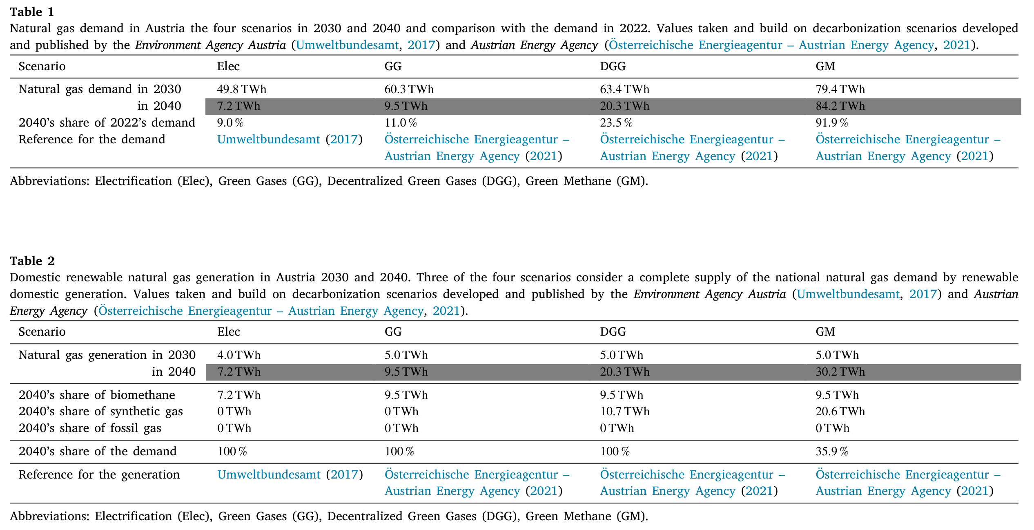
Scenarios: “What-If” Perspective

Slide 6
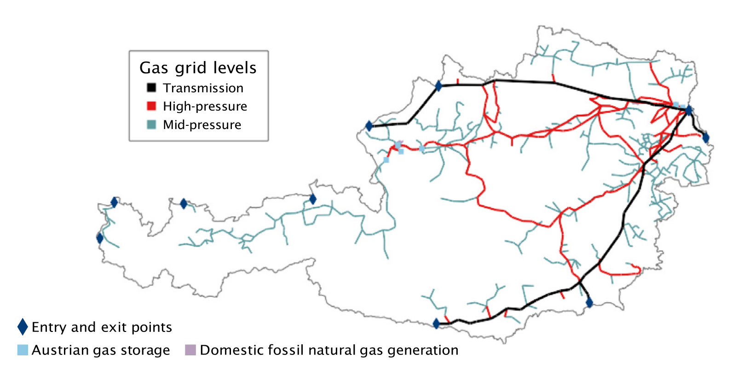
Representation of the Existing Natural Gas Grid in the Model
738 pipeline sections (lines) and 657 supply and demand points (nodes).

Slide 7
Main Decision Variables of the Model
Operation, decommissioning, or replacement investment in pipelines

Slide 8
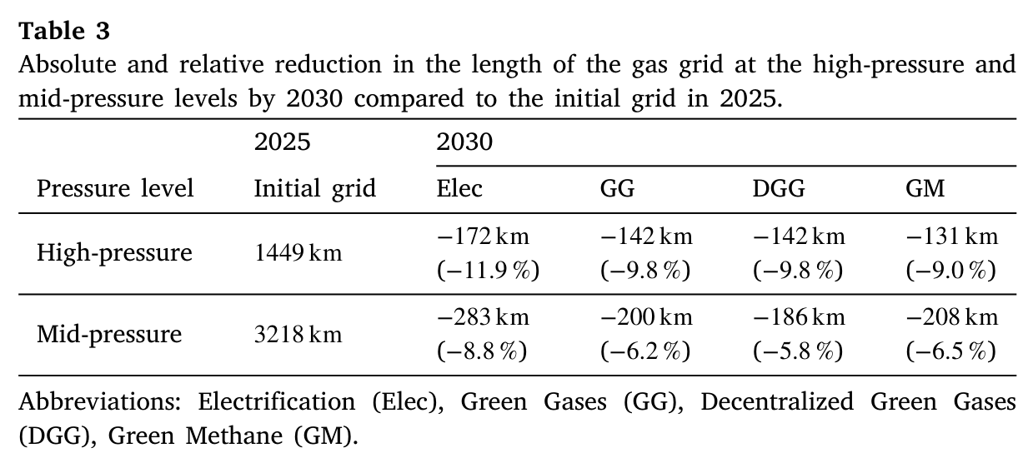
Results: Austria’s Natural Gas Grid in 2030

Slide 9
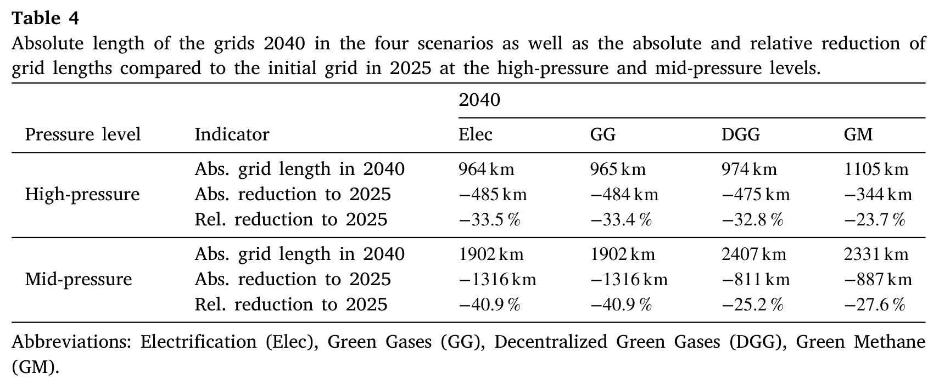
Results: Austria’s Natural Gas Grid in 2040

Slide 10
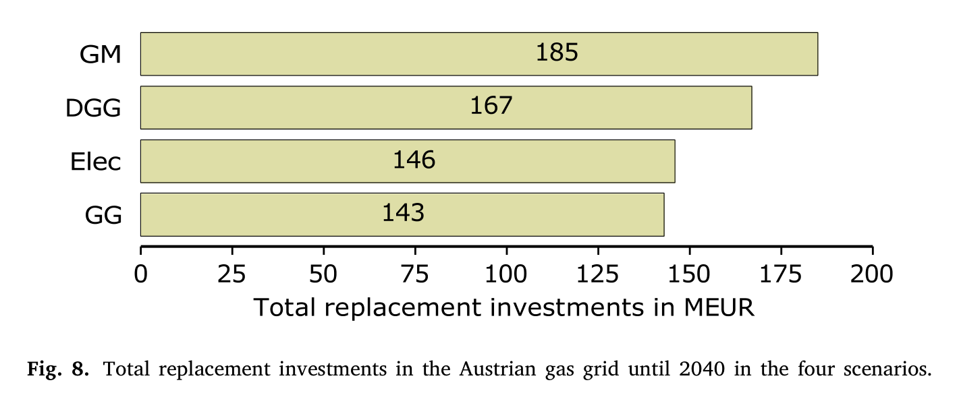
Results: Aging and related Replacement Investments

Slide 11
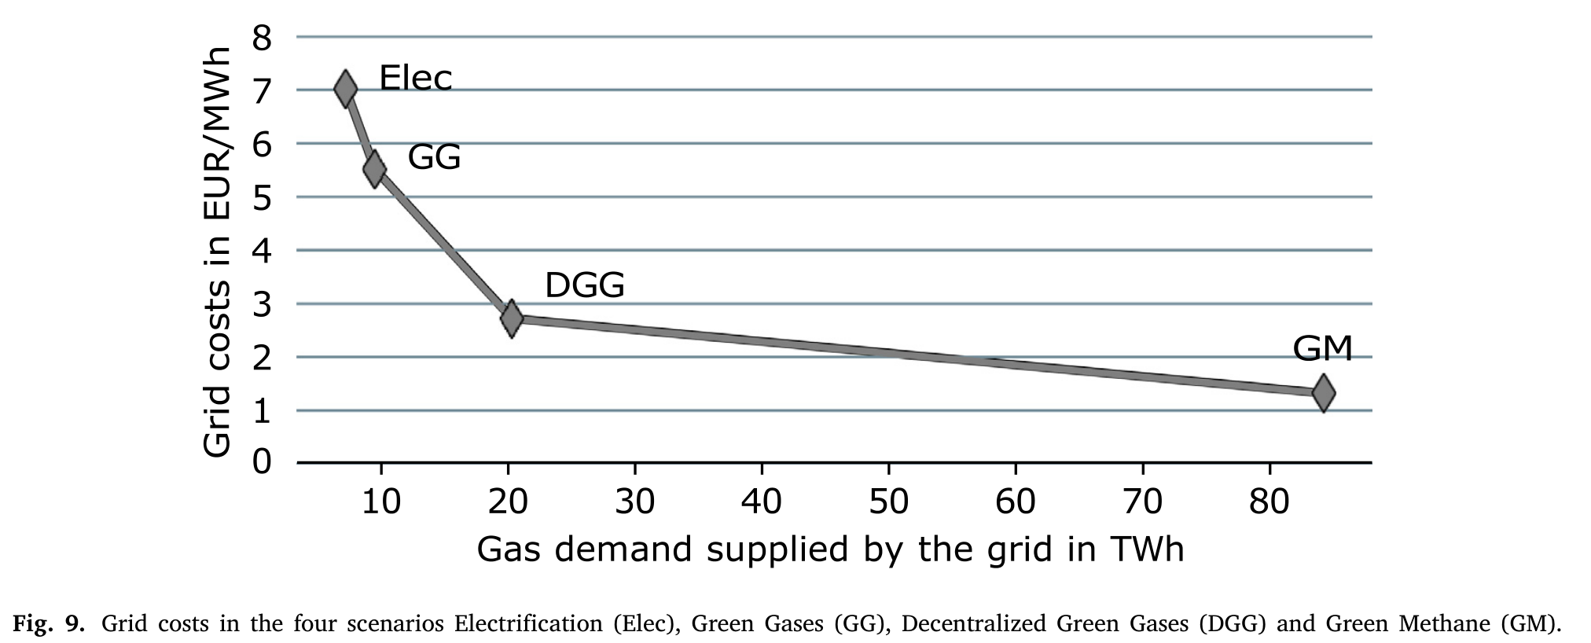
Results: Average Grid Costs in 2040

Slide 12
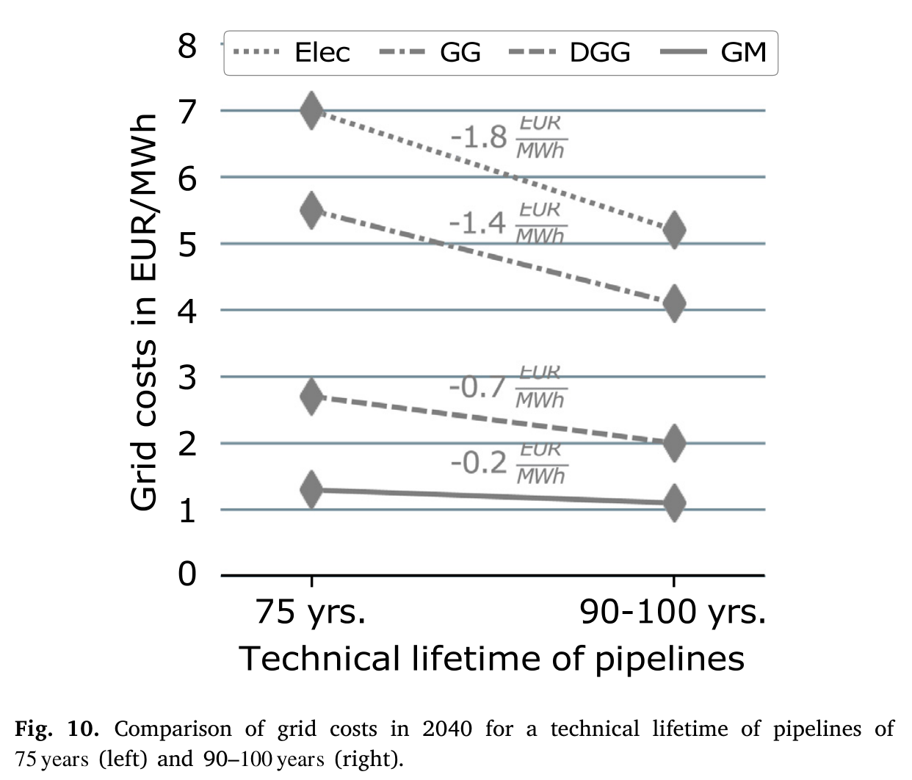
Results: Impact of the Technical Lifetime of Pipelines

Slide 13
Conclusions
Austria’s natural gas grids will shrink in the future; the natural gas demand will likely be spatially concentrated and restricted to large consumers
The size of gas grids will be determined, on the one hand, by the quantities of domestic generation (and demand), on the other hand, by their spatial location
If an area-wide integration of domestic renewable gases into the gas grid happens, a significant increase in average grid costs and grid tariffs for the end customers must be expected
The aging of the existing gas grid and related refurbishment investments play a relatively minor role in the gas grid costs, as fixed costs mainly determine them
The final finding on the increase in gas grid costs for large-scale renewable gas injection can be a starting point for further work

